Slide 1
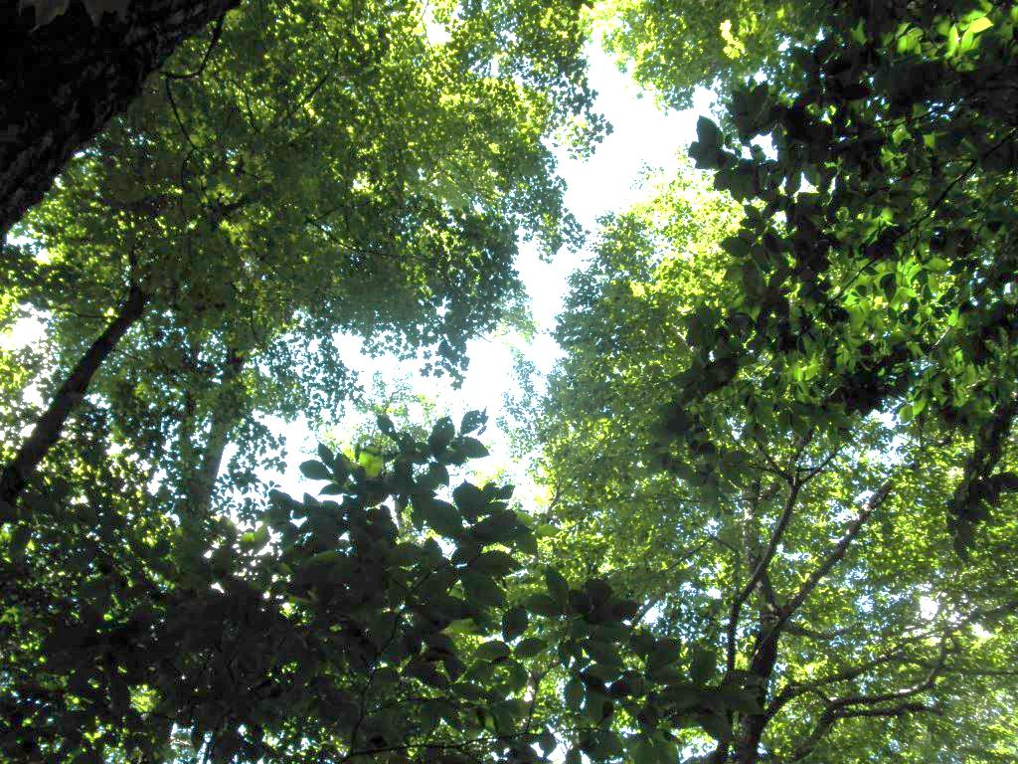
Vermont’s Future Forests
Sandy Wilmot
Forests, Parks & Recreation
Notes:
We are in an uncertain time when rules we’ve discovered about forest processes are changing. Part of this is due to our land use practices. Forest successional stages don’t necessarily get played out if forests are manipulated to favor some species above others. New pests are singling out certain species. Temperatures and weather patterns are changing seed beds and regeneration opportunities. Invasive plants are expanding into new areas outcompeting native species. Storms, flooding, wind events, ice storms and shorter winters create unpredictable growing conditions. Here I will present data from annual assessments of forest health, pest monitoring, a 2012 Timber Harvest Assessment, and the US FS Forest Inventory and Assessment 5-year report to look at the current overstory and the near-future regeneration in an attempt to see what our future forests will be without any significant changes.

Slide 2
Data and Source Credits
Forest Inventory and Assessment plots
  USDA Forest Service
Aerial survey
  Forests, Parks & Recreation
North American Maple Project plots
  Forests, Parks & Recreation
VMC Forest Health plots
  FPR and UVM Pontius Crew
Invasive pests
  FPR, USDA APHIS, Agency of Agriculture, UVM Extension, VT Forest First Detectors Volunteers
Timber Harvest Assessment
  FPR, Grant from USDA Forest Service

Slide 3
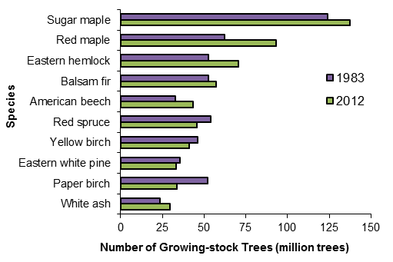
Most Abundant Tree Species
Morin et al 2014 (In Press)
Notes:
Relative volumes of species shows sugar maple dominating volumes of growing stock.

Slide 4
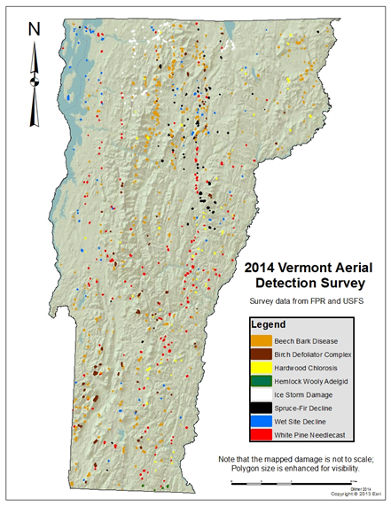
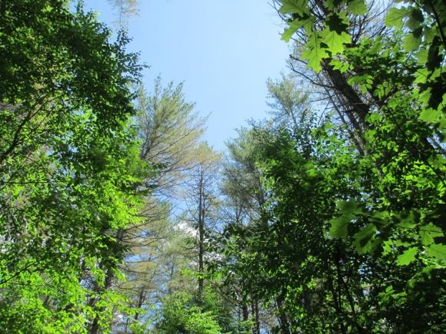
Current Conditions
Forests, Parks & Recreation 2014

Slide 5
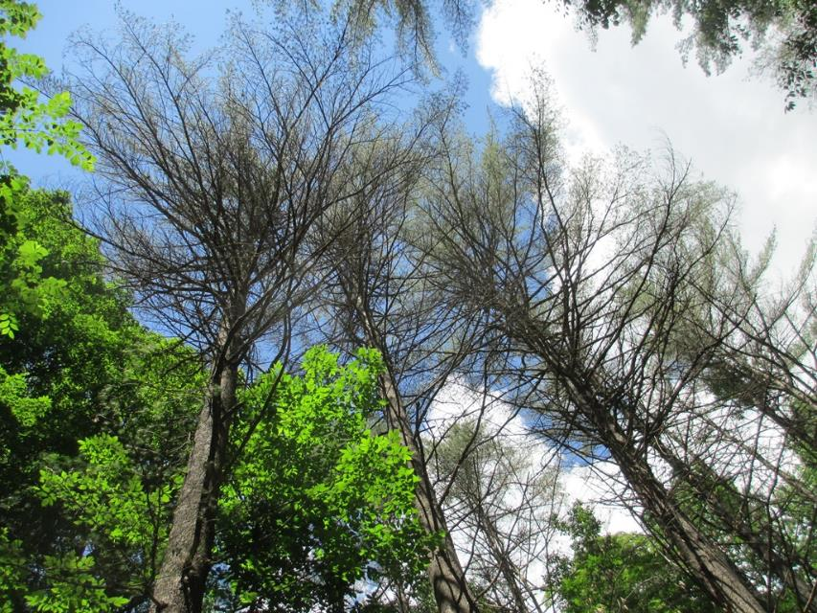
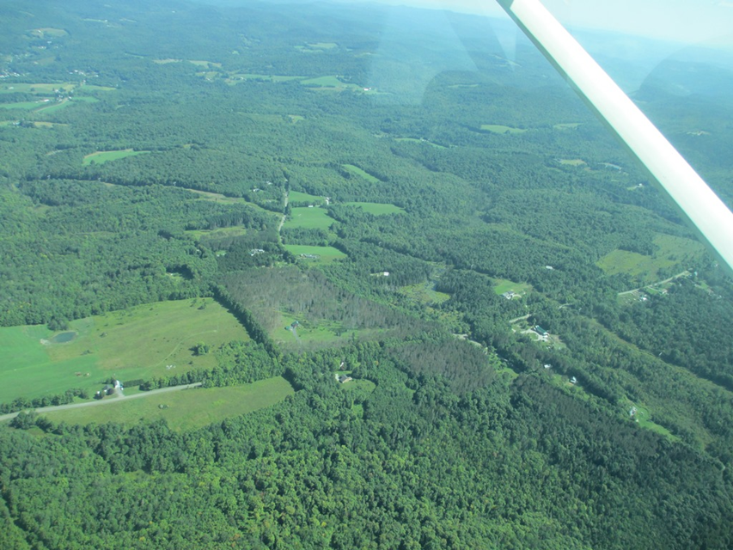
Persistent White Pine Needle Diseases
Unknown Cause of Red Pine Disease

Slide 6
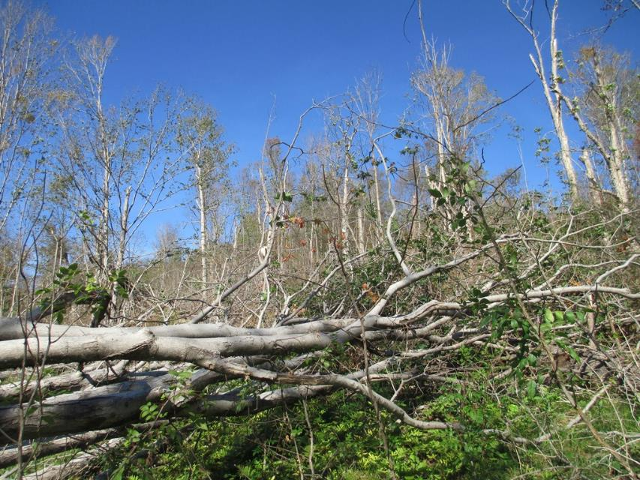
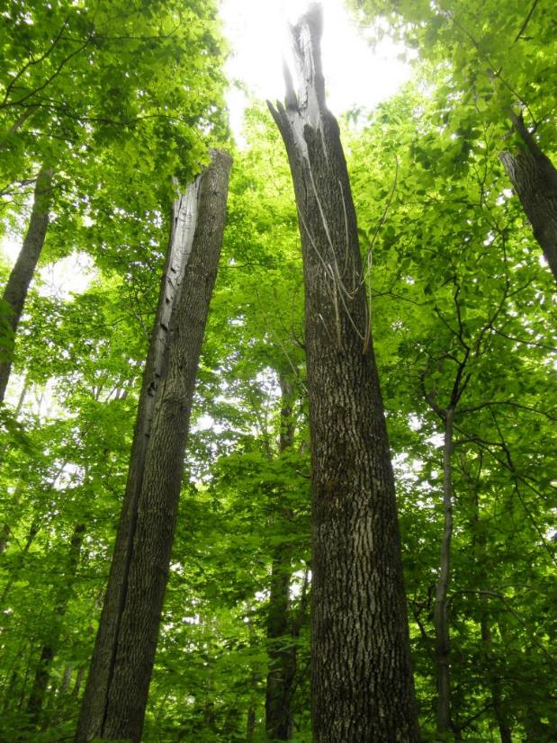
Wind Storms and
Ice Storm

Slide 7
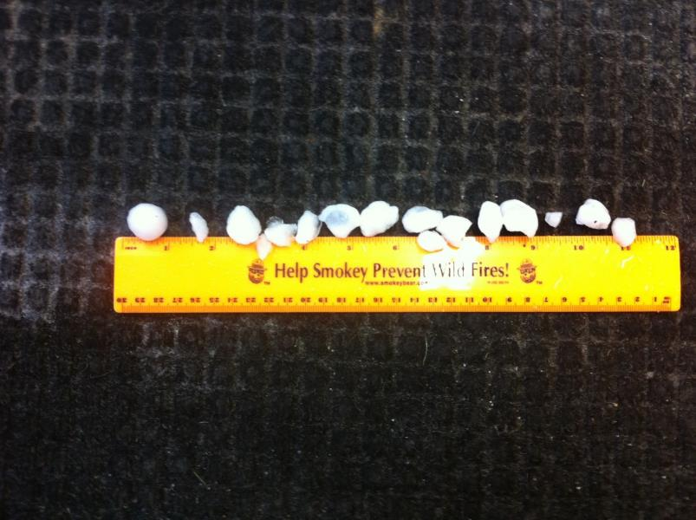
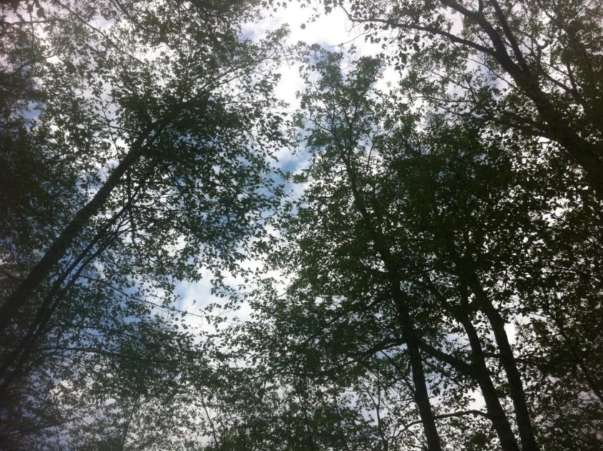
Hail Damage

Slide 8
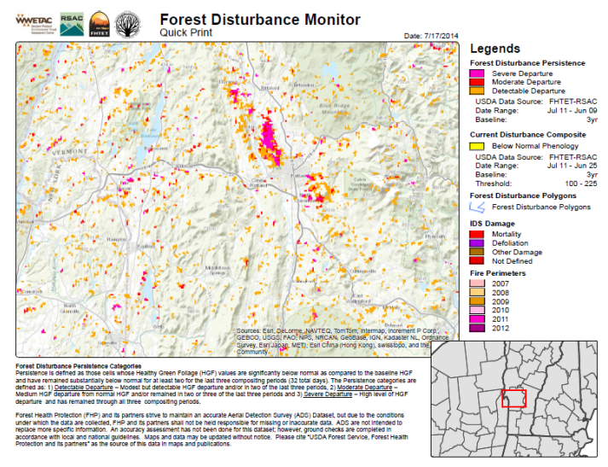
-Rutland County July Storms

Slide 9
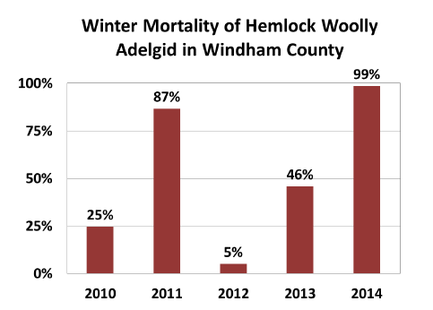
Hemlock Woolly Adelgid
Forests, Parks & Recreation 2014

Slide 10
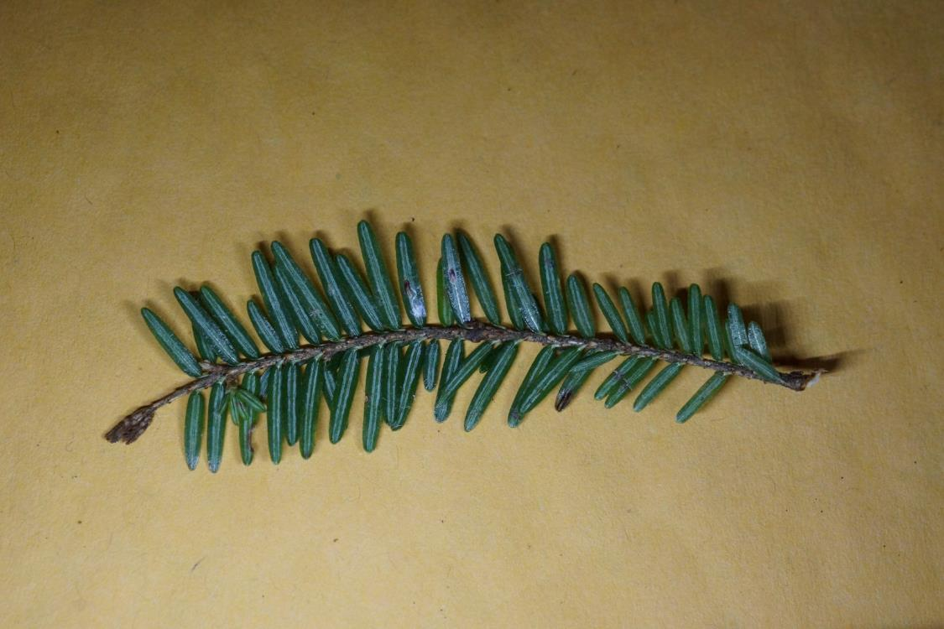
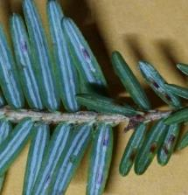
Elongate Hemlock Scale
A New Non-native Pest

Slide 11
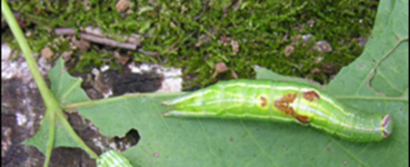
Saddled Prominent Traps
Forests, Parks & Recreation 2014

Slide 12
Sugar Maple Crown Health
North American Maple Project
Forests, Parks & Recreation 2014

Slide 13
Sugar Maple Health
New Dead Overstory Trees
Forests, Parks & Recreation 2014

Slide 14
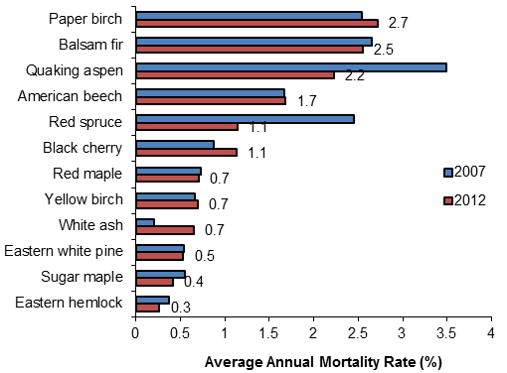
Statewide Mortality Ranked By Species
Average for all species = 0.8%.
Morin et al 2014 (In Press)
Notes:
Species with mortality rate greater than statewide average of 0.8% of trees per year are: paper birch, balsam fir, quaking aspen, beech, red spruce and black cherry. Most of these species seem to be recovering since 2007, except beech and black cherry.

Slide 15
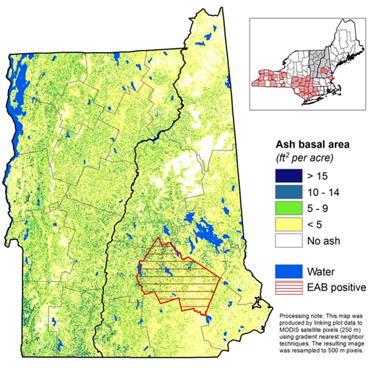
Distribution of ash, 2012
(EAB positive counties as of March 11, 2013)
Morin et al 2014 (In Press)
Notes:
Risk assessments include ash loss from EAB.

Slide 16
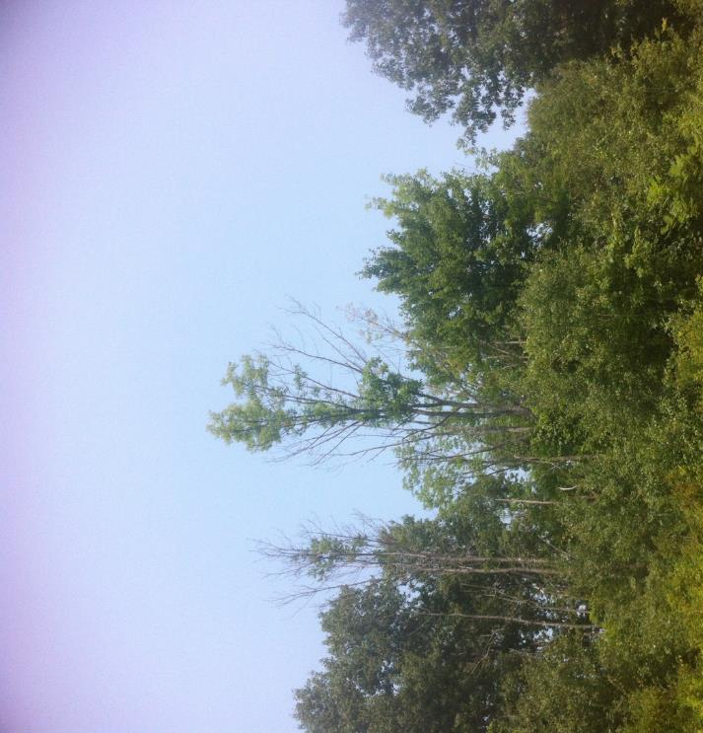
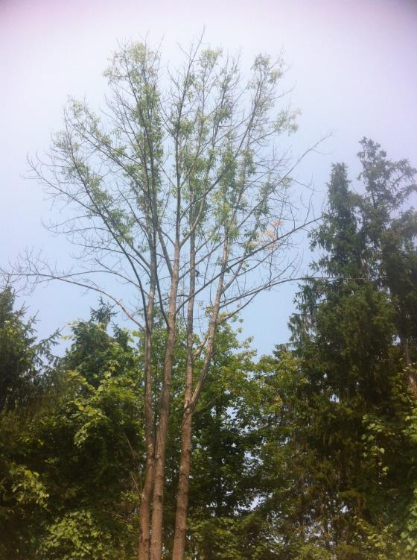
Ash Declines

Slide 17
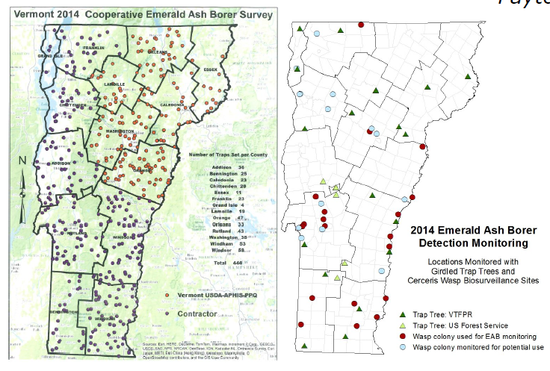
Emerald Ash Borer Monitoring

Slide 18
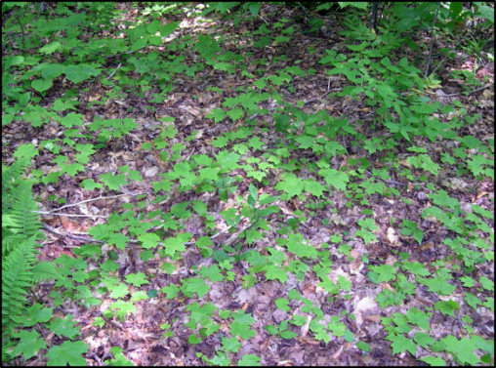
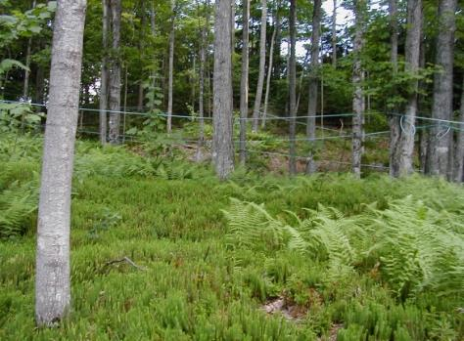
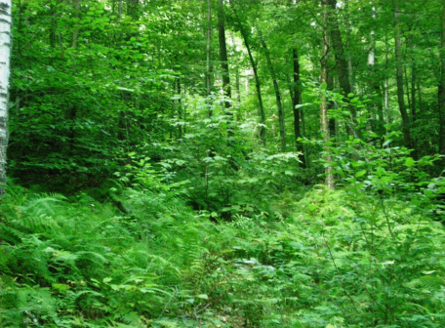
Regeneration – The Future Forest

Slide 19
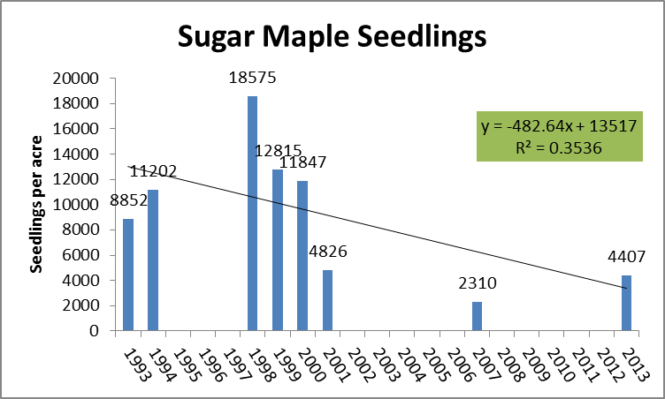
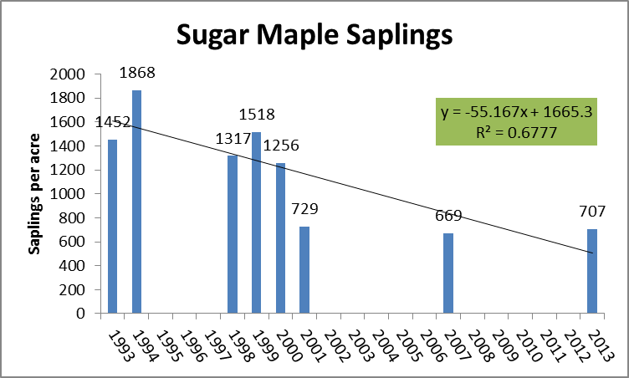
Sugar Maple Regeneration
North American Maple Project
Forests, Parks & Recreation 2014

Slide 20
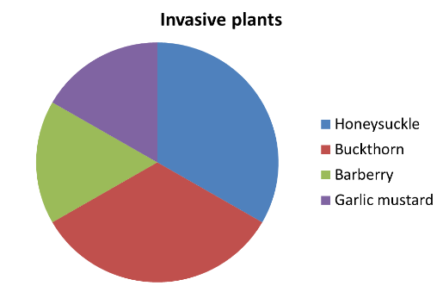
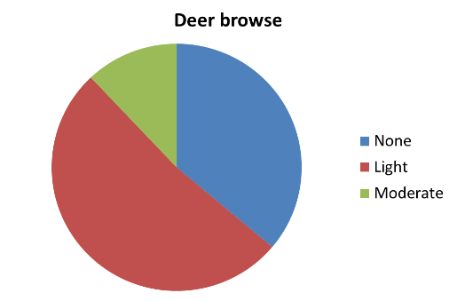
Factors affecting regeneration success:
Light reaching the forest floor
Soil conditions
Diseases and pests (including deer browse)
Competitive vegetation
Growing requirements
In 2013, 20% of the 30 sugar maple monitoring plots had invasive plants…..
and 60% had light or moderate deer browse on regeneration.
Forests, Parks & Recreation 2014

Slide 21
Mount Mansfield
East Slope
Forests, Parks & Recreation 2014

Slide 22
Mount Mansfield
West Slope

Slide 23
Lye Brook Saplings
Forests, Parks & Recreation 2014

Slide 24
Timber Harvest Assessment - 2012
Understory Assessment at 80 sites
Forests, Parks & Recreation 2014

Slide 25
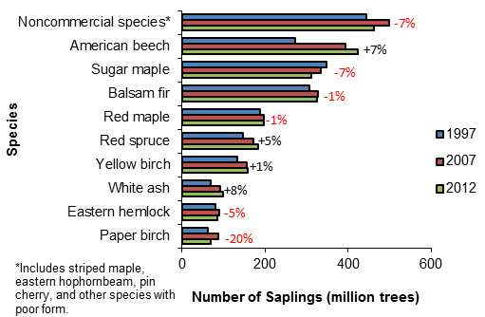
Statewide Trends in Sapling Abundance
Morin et al 2014 (In Press)
Notes:
Regeneration is dominated by non-commercial species. White ash, beech, red spruce and yellow birch were the only species to increase in abundance over the past 5 years. Paper birch saplings were 20% less, and sugar maple and non-commercial species were each reduced by 7%.

Slide 26
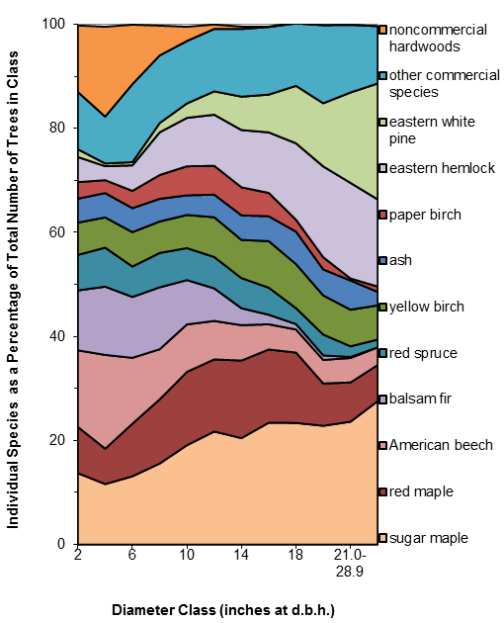
Species Abundance By Diameter Class
Morin et al 2014 (In Press)
Notes:
Another way to see relative composition is by species and diameter class as a percent of total trees. Note the high percentage of noncommercial hardwoods in the small size classes and the small regeneration compared to overstory trees.

Slide 27
Vermont’s Future Forests?
Tree mortality
  Paper birch
Invasive Pests
  Hemlock
  Ash
Regeneration failures
  Sugar maple
Regeneration successes
  Beech
  Balsam fir
Climate change projections
  Less balsam fir, sugar maple, yellow birch
  More oak, hickory, pines

